Slide 1
CSE7301 - INTERNSHIP Final Review- Presentation DATA DRIVEN SOLUTION FOR CONNECTING EDUCATION AND EMPLOYMENT
Student Details
Name | DHANUSH CR
Roll No | 20211CSE0671
Section | 8CSE15
Under the Supervision of,
Mr. SYED MOHSIN ABBASI
Assistant Professor
School of Computer Science and Engineering
Presidency University
Name of the Program: B.Tech
Name of the HoD: Dr. ASIF MOHAMED H B
Name of the Program Project Coordinator: Mr. Jerrin Joe Francis
Name of the School Internship/Project Coordinators: Mr. Md Ziaur Rahman / Dr. Sampath A K

Slide 2
Content
About Company or Organization
Working domain or the technology
About your team and reporting Manager
Challenges Faced in Internship
Objectives of the work
Importance of Technology
Internship Roadmap
Sustainable Development Goals (SDGs)
Github Link

Slide 3
About Company or Organization
UptoSkills
Overview
UptoSkills is a leading Indian skill-tech company that focuses on enhancing professional competencies through diverse programs and services.
Key Highlights
Over 1,000 professionals and students trained in fields like Computer Science, Mechanical, Electronics, Electrical, and Civil Engineering over the past four years.
Offers free internships, job opportunities, online courses, MBA programs, hackathons, competitions, and faculty development programs.
Hosts the UptoSkills Podcast Show and offers opportunities to become a trainer.

Slide 4
About Company or Organization
Industry Impact
Collaborates with colleges and corporations to deliver industry-relevant training programs for career transformation.
Provides recruitment solutions to help businesses find the right talent.
Contact Information
Location: Palam, New Delhi
Email: info@uptoskills.com
Phone: +91-9319772294
Website: www.uptoskills.com

Slide 5
Working domain or the technology
Assigned Domain/Technology: Data Analyst
Key Features of Data Analysis
Data-Driven Insights : Transform raw data into meaningful insights that help businesses make informed decisions.
Tools and Technologies : Excel, Power BI, Azure Data Lake Storage, Azure Data Bricks
Data Cleaning and Preprocessing : Ensure data accuracy and quality by cleaning and preparing datasets for analysis.

Slide 6
Working domain or the technology
Importance
Improved Decision-Making: Data analysis provides organizations with actionable insights, enabling smarter decisions.
Performance Tracking: Monitor the success of various initiatives, such as training programs, customer engagement.
Benefits of Data Analysis Internship
Skill Development: Helps to gain expertise in industry-standard tools like SQL, Power BI, or Python.
Real-World Application: Work on meaningful projects that directly contribute to the company’s growth.

Slide 7
About your team and reporting Manager
Team Structure
Total Members: 1 Team Leader and 10 Interns (including me) : Responsible for data mining and Data Analysis in assigned cities or districts.
Responsibilities: Each intern is assigned a specific city or district in a particular state.
As interns we collect Training and Placement Officer (TPO) details (Name, Phone Number, Email) of engineering colleges.
Moved on to collect Email and Contact details of Hiring Managers of companies hiring freshers in multiple domains.
Analysis of the collected data for meaningful insights that drive business decisions.
Working Project: Data Analysis
Gather details of Training and Placement Officers (TPOs) from engineering colleges across India.
Collect details of Hiring Managers hiring for various roles in their organization.
Team Leader assigns each intern a specific city/district.

Slide 8
About your team and reporting Manager
Data Mining
Search online sources like college websites, directories, or government education portals.
Compile the data into Excel sheets with fields for Name, Phone Number, Email, and College Name.
Data Analysis
Analysis of collected data that gives meaningful insights.
Daily Reporting : Submitting completed data to the Team Leader for review and consolidation.
Timeline
First 20-25 days dedicated to data mining.
Data Analysis task after data mining.

Slide 9
Challenges Faced in Internship
Challenges in Data Mining
Data Availability: Finding authentic and reliable information of HR and TPO details across various sources.
Accuracy: Ensuring the collected data is correct and up to date.
Tedious Process: The repetitive and time-consuming nature of searching and verifying details.
Challenges in Interview Preparation
Difficulty in understanding the exact skill set and experience needed for a specific role.

Slide 10
Objectives of the work
Building a Comprehensive Database
Collect accurate and up-to-date contact details of TPOs) across engineering colleges in India and collect HR details to offer Corporate Trainings.
Streamline communication between UptoSkills and colleges for recruitment, training programs, and collaborations.
Enhanced Outreach
Leverage the TPO and HR database to expand UptoSkills’ network across various colleges and companies
Conduct awareness campaigns about UptoSkills’ programs and services.
Future Analytics
Use the collected data for analysis, such as understanding the geographical distribution of colleges and Organizations that are actively hiring
Identify regions requiring more focus for marketing and training efforts.

Slide 11
Literature Review
Role of Data Collection in Industry
Data collection is a fundamental step in building business intelligence and recruitment
Internships as a Learning Opportunity in Data Analysis
Working on real-world data sets helps interns develop analytical thinking, accuracy, and problem-solving skills.
(PDF) Role of Data Analytics in Business Decision Making
Impact of Data-Driven Decision Making
Companies use data-driven strategies to optimize recruitment and partnership-building.
Importance of Data Mining in Information Retrieval
Efficient data mining enhances company partnerships, recruitment strategies, and decision-making by identifying key industry contacts.

Slide 12
Proposed System / Work
Covered multiple cities across different states in India.
Data Collection
Mined TPO contact details (name, email, phone) from colleges
Categorized job roles by domain (IT, Core, Analytics, etc.).
Collected company/job data including role, skills, mode of works.
Cloud-Based Storage and Processing
Used Azure Data Lake Gen2 for centralized data storage.
Organized files hierarchically (by college, domain, etc.) using ADLS namespaces.

Slide 13
Proposed System / Work
Data Processing
Used Azure Databricks with PySpark for big data handling.
Cleaned data (duplicates, nulls, inconsistencies).
Categorized job roles by domain (IT, Core, Analytics, etc.).
Analyzed skill trends and hiring patterns.
Visualization & Insights
Created interactive dashboards in Power BI.
Visualized skill frequency using tree maps.
Showed hiring trends by city, domain, and mode (Remote/On-site).

Slide 14
Problem Statement
DATA DRIVEN SOLUTION FOR CONNECTING EDUCATION AND EMPLOYMENT
The gap between industry job requirements and the training offered by engineering colleges in India leads to mismatched skills and missed employment opportunities. There's a need for a scalable, data-driven system to analyze and bridge this disconnect.
Key Issues:
Lack of structured data on college training programs vs. job market demands
Difficulty identifying relevant skill gaps across domains and regions
Manual data collection limits scalability and insight generation
Absence of centralized visualization for stakeholders to act upon

Slide 15
System Requirements
1. Hardware Requirements
Laptop or Desktop – For research, data entry, and analysis.
Stable Internet Connection – Essential for online data mining and communication.
2. Software Requirements
Microsoft Excel – For storing and organizing HR and TPO contact details.
Web Browsers (Chrome, Edge, etc.) – For researching and extracting data.
GitHub – For version control, collaboration, and storing reports.
Power BI – For data visualization and generating insights from collected data.
Azure Data Bricks – For Data Processing

Slide 16
Advantages of Proposed System/Work
1. Improved Business Outreach
Enables the company to identify and connect with potential HRs and TPOs, leading to more business opportunities.
2. Data-Driven Decision Making
Helps the company analyze collected data to prioritize outreach and target the most relevant contacts.
3. Increased Efficiency in Contact Collection
Reduces manual effort and time spent searching for HR and TPO details through structured data mining.

Slide 17
Advantages of Proposed System/Work
4. Centralized & Organized Data Storage
Maintains a well-structured database of contacts, preventing loss of information and duplication.
5. Enhanced Business Growth & Partnerships
Facilitates better collaboration between companies and colleges, improving recruitment and partnership deals.
6. Better Insights with Power BI
Provides visual reports and dashboards that help understand trends and improve outreach strategies.

Slide 18
Importance of Technology
1. Cloud Storage (ADLS)
Centralized and scalable data storage
Supports structured & unstructured formats
Easy access for distributed teams
Enables folder-level organization with hierarchical namespace
2. Cloud Storage (ADLS)
Centralized and scalable data storage
Supports structured & unstructured formats
Easy access for distributed teams
Enables folder-level organization with hierarchical namespace

Slide 19
Importance of Technology
3. Big Data Processing (Azure Databricks + PySpark)
Handles large educational & job datasets efficiently
Allows parallel, distributed data processing
Ideal for cleaning, grouping, and skill-trend analysis
Reduces processing time significantly
. Visualization Tools (Power BI)
Converts complex data into understandable visuals
Enables trend spotting and decision-making
Interactive dashboards for easy understanding

Slide 20
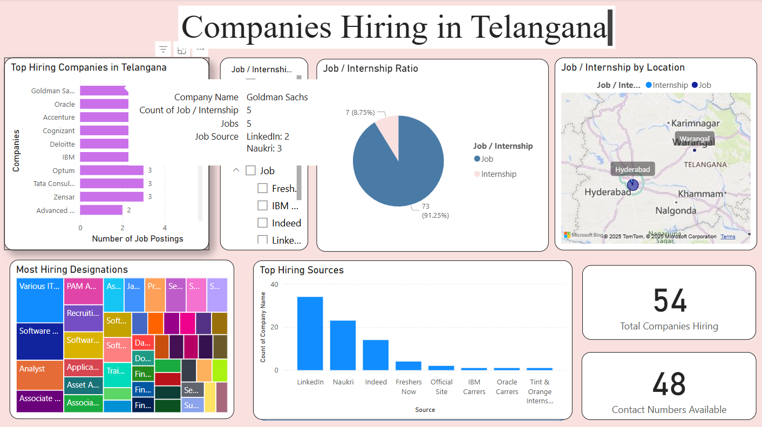
Implementation

Slide 21
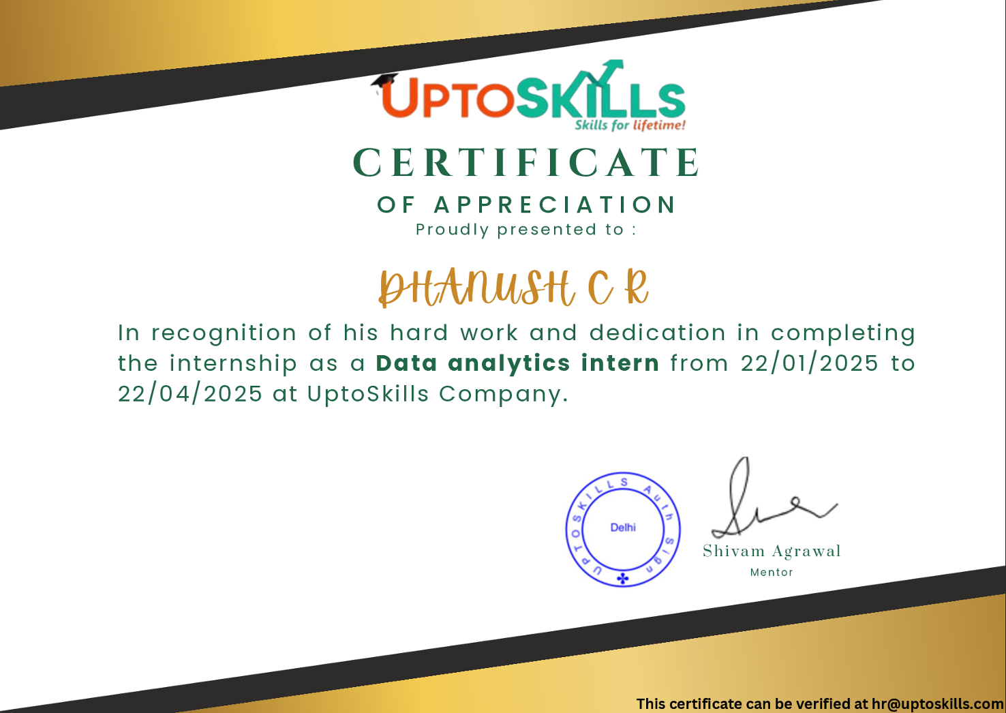
Internship Completion Certificate

Slide 22
Internship Road Map
Note: Write in the below table what u will be achieving in each review
Review 0
Overview of company, domain, technology, team, and reporting manager
Review 1
Define project scope, literature review, objectives, problem statement
Review 2
Present design, methods, tools, 50% implementation, and demo
Review 3
Complete implementation, source code, and live demo

Slide 23
Sustainable Development Goals
1. SDG 4: Quality Education
Goal: Ensure inclusive and equitable quality education and promote lifelong learning opportunities for all.​
Project Alignment
Our platform's personalized learning paths and multilingual support ensure that learners from diverse backgrounds, including those with disabilities and non-native language speakers, have equitable access to educational resources and career guidance.
2. SDG 8: Decent Work and Economic Growth
Goal: Promote sustained, inclusive and sustainable economic growth, full and productive employment and decent work for all.​
Project Alignment
By analysing educational backgrounds and employment trends, the system identifies skill gaps and recommends targeted training programs. This proactive approach facilitates smoother transitions from education to employment, aiming to reduce youth unemployment and underemployment rates.​

Slide 24
Sustainable Development Goals
3. SDG 9: Industry, Innovation, and Infrastructure
Goal: Build resilient infrastructure, promote inclusive and sustainable industrialization, and foster innovation.​
Project Alignment
The integration of AI-driven analytics and machine learning models in the platform exemplifies technological innovation in the education and employment sectors. By leveraging data to inform decision-making, the project contributes to upgrading technological capabilities and encourages further research and development
4. SDG 10: Reduced Inequalities
Goal: Reduce inequality within and among countries.​
Project Alignment
The platform's focus on personalized learning paths and employment opportunities ensures that individuals from marginalized communities receive support tailored to their unique circumstances. By addressing barriers to education and employment, the project fosters greater social and economic inclusion.​

Slide 25
Github Link
https://github.com/dhanushcrm/Data-Analytics

Slide 26
Q&A

Slide 27
Thank you !!

